Slide 1
Assessing the Least Squares Fit
Part 1
BUAN/ MECO 6312
Dr. Moran Blueshtein
University of Texas - Dallas

Slide 2
Assessing the Least Squares Fit
THE LEAST SQUARES ESTIMATORS
Least Squares estimators are random variables!

Slide 3
Assessing the Least Squares Fit
How good are the Least Squares estimators?
What good properties are we looking for?
Unbiasedness -> E(b₂) = β₂
Minimal variance (efficiency)
Consistency
How do the Least Squares estimators compare to alternative estimators?

Slide 4
Assessing the Least Squares Fit
Unbiasedness
Unbiasedness
The property of unbiasedness means that if we took the averages of estimates from many samples, these averages would approach the true parameter.
Unbiasedness does not mean that an estimate from any one sample is close to the true parameter.

Slide 5
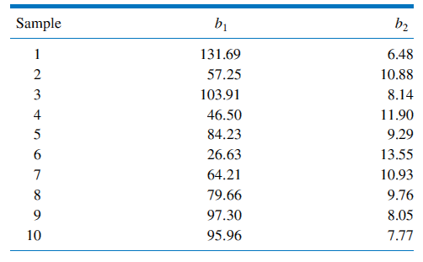
Assessing the Least Squares Fit
Estimates from 10 Samples
Repeated Sampling

Slide 6
Assessing the Least Squares Fit
Unbiasedness
Unbiasedness
If our model assumptions hold, then E(b₂) = β₂, which means that the OLS estimator is unbiased.
Let’s prove it!

Slide 7
Assessing the Least Squares Fit
The Estimator b₂
The estimator b₂
can be also written as:
Let’s denote
So:

Slide 8
Assessing the Least Squares Fit
The Estimator b₂

Slide 9
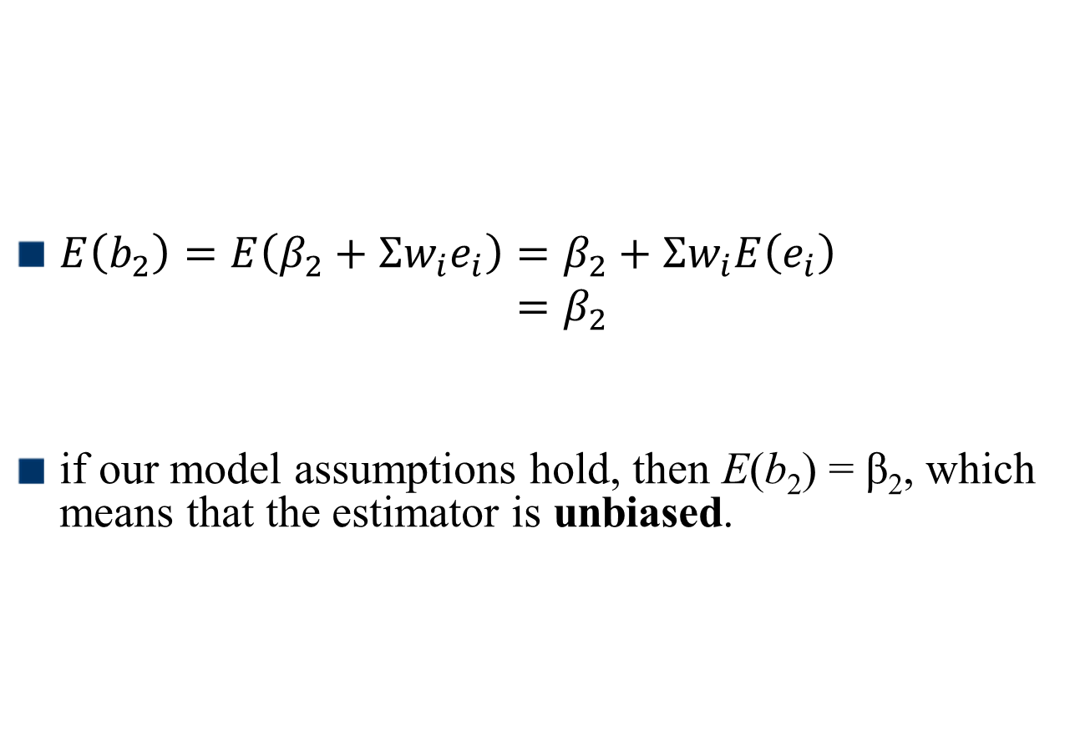
Assessing the Least Squares Fit
The Expected Values of b₂
$E\left(b_{2}\right)=E\left(β_{2}+Σw_{i}e_{i}\right)=β_{2}+Σw_{i}E\left(e_{i}\right)$ $=β_{2}$
if our model assumptions hold, then E(b₂) = β₂, which means that the estimator is unbiased.

